Slide 1

Minimum Viable Product
Max Dunaevschi, Shalini Rao, Blythe Weng

Slide 2
Project Overview
Distribute goods to food insecure communities
Scanning inventory system
Reduce time and human error creating invoices
Extensive market research with other organizations
Notes:
We are working with the GWCFB to find a scanning inventory system, so that they can better manage their inventory and distribution. This adds value by reducing the time it takes to generate invoice reports as well as reduce human error associated with miscounted items, ultimately allowing the org to focus more time on feeding more of the local community. We do this differently by conducting extensive market research with different food banks and inventory management systems to understand the functionality and benefits of their products. As a result, employees will be able to electronically scan items into an invoice instead of manually inputting them and risking mistakes in their reporting later on. We’re helping GWCFB fix food insecurity, one scan at a time.

Slide 3
Project Overview
Distribute goods to food insecure communities
Scanning inventory system
Reduce time and human error creating invoices
Extensive market research with other organizations
We’re helping GWCFB fix food insecurity, one scan at a time.
Notes:
We are working with the GWCFB to find a scanning inventory system, so that they can better manage their inventory and distribution. This adds value by reducing the time it takes to generate invoice reports as well as reduce human error associated with miscounted items, ultimately allowing the org to focus more time on feeding more of the local community. We do this differently by conducting extensive market research with different food banks and inventory management systems to understand the functionality and benefits of their products. As a result, employees will be able to electronically scan items into an invoice instead of manually inputting them and risking mistakes in their reporting later on. We’re helping GWCFB fix food insecurity, one scan at a time.

Slide 4
Key Client Needs and Priorities
Move inventory off of current software (Quickbooks)
Scanning capability for shipments and distributions
Reduce possibility of human error and fixes
Improve efficiency of manual data entry and reporting

Slide 5
Inventory Analysis
HandiFox
A scanning system extension to QuickBooks, the current software GWCFB is using.
Pro: Quickbooks integration
Con: Still have to use misfit software
Notes:
shalini

Slide 6
Inventory Analysis
HandiFox
A scanning system extension to QuickBooks, the current software GWCFB is using.
Pro: Quickbooks integration
Con: Still have to use misfit software
Sortly
User-friendly database for mobile-compatible inventory management.
Pro: User-friendly UI, large inventory space, and automatic alerts
Con: Populate app with inventory from scratch
Notes:
shalini

Slide 7
Inventory Analysis
HandiFox
A scanning system extension to QuickBooks, the current software GWCFB is using.
Pro: Quickbooks integration
Con: Still have to use misfit software
Sortly
User-friendly database for mobile-compatible inventory management.
Pro: User-friendly UI, large inventory space, and automatic alerts
Con: Populate app with inventory from scratch
FoodBank Manager
An inventory software designed specifically for Food Banks.
Pro: Specifically designed for food banks
Con: Still in beta stage, may have small bugs
Notes:
shalini

Slide 8

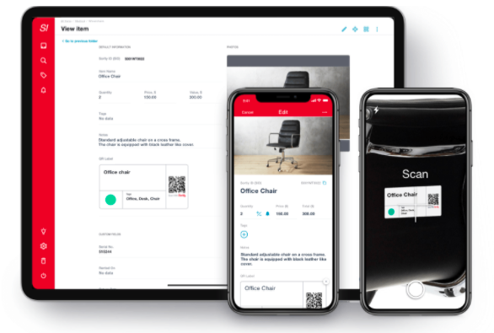
Final Decision
Pricing within budget range
Separate inventory system
Good user interface (easy for new users)
Mobile phone scanning system
Support
Possible expansion
Notes:
Key feature was the yearly price of $468
One of the key priorities for Jon was having a standalone software separate to Quickbooks. He wants to move all operations off of Quickbooks and into a new system. Sortly offers 2000 unique items which definitely covers the 300 that GWCFB has.
Offers compatibility with both iphone and android devices
They have a help desk which is very responsive. For example, when Shalini set up a meeting with them, they responded within 10 minutes. They also have a phone number you can call to talk directly with a help-desk worker.
Jon specifically mentioned that this is a program that they can possibly use on multiple fronts as they develop programming in other departments.

Slide 9
Next Steps
1
Start sortly free trial
Learn the ins and outs of the software
Create list of features to test during free trial
Documentation of program functionalities
2
3
4

Slide 10
Thank you!
Any Questions?

